Slide 1
Logistic Regression

Slide 2
What is Regression?
is a type of supervised learning used to predict continuous numerical values based on input data.
Purpose: the relationship between a dependent variable (target/output) and one or more independent variables (features/inputs).

Slide 3
Types of Regression
Type | Description | Output Type
Linear Regression | Assumes a linear relationship | Continuous value
Logistic Regression | Used for classification (outputs probabilities) | Binary/Probability
Polynomial Regression | Models curved relationships | Continuous value
Ridge/Lasso Regression | Regularized linear models to reduce overfitting | Continuous value

Slide 4
Logistic Regression
is a supervised machine learning algorithm used for classification tasks, especially binary classification (e.g., spam or not spam, yes or no, 0 or 1).
Despite the name “regression,” it is used for classification, not regression.

Slide 5
Purpose of Logistic Regression
To predict the probability that a given input belongs to a certain class (typically class 1).
It outputs values between 0 and 1, which represent probabilities.

Slide 6
Key Concepts
Binary Classification: Predicts one of two possible outcomes (0 or 1, Yes or No, etc.)
Probability Output: Returns probabilities between 0 and 1
Sigmoid Function: Maps any real number to a value between 0 and 1
Maximum Likelihood Estimation: Method used to find optimal parameters

Slide 7
Mathematical Formulation
The Sigmoid Function
The sigmoid function is the core of logistic regression:
σ(z) = 1 / (1 + e^(-z))
Where:
z = β₀ + β₁x₁ + β₂x₂ + ... + βₙxₙ
β₀ is the intercept
β₁, β₂, ..., βₙ are the coefficients
x₁, x₂, ..., xₙ are the features

Slide 8
Decision Rule
Probability (σ(z)\sigma(z)) | Class Output
≥ 0.5 | Class 1
< 0.5 | Class 0

Slide 9


Linear Regression vs Logistic Regression
Feature | Linear Regression | Logistic Regression
Goal | Predict continuous values | Predict binary /discrete values
Output Range | Any real number: (−∞, ∞) | Probability: (0, 1)
Function Used | Linear function | Sigmoid (logistic) function
Equation
Problem Type | Regression problems | Classification problems
Example Use Case | Predicting house prices, sales, temperature | Predicting spam, disease, churn (yes/no)
Error Metric | Mean Squared Error (MSE), RMSE | Cross-Entropy Loss, Log-Loss
Decision Threshold | Not required | Required (usually 0.5)
Output Interpretation | Direct value | Probability of class 1

Slide 10
Gradient Descent in Logistic Regression
is an optimization algorithm used to find the best model parameters (weights) by minimizing the loss function.
it helps the model learn from the data by
adjusting the weights step by step to reduce the error between
the predicted and actual values.

Slide 11
Key points
It starts with random weights.
Calculates predictions using the sigmoid function.
Measures the error using log loss.
Updates the weights in the direction that reduces the error.
Repeats this process until the model performs well.

Slide 12
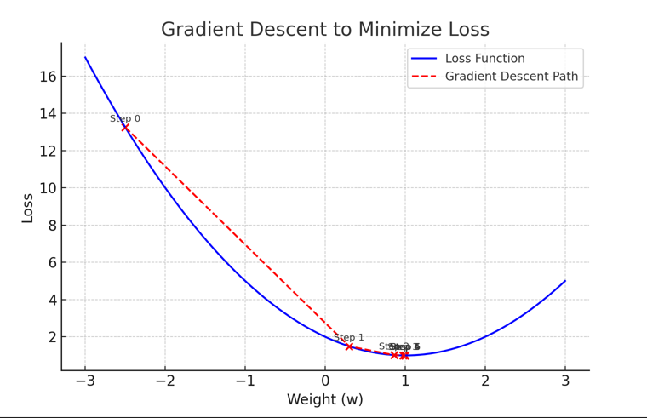

Slide 13
Real-world Applications of Logistic Regression
Email Spam Detection
Classify emails as Spam or Not Spam based on keywords and sender behavior.
Medical Diagnosis
Predict whether a patient has a disease (e.g., diabetes, cancer) based on symptoms and test results.
Customer Purchase Prediction
Determine if a customer will buy a product based on browsing and purchase history.
Credit Risk Assessment
Assess whether a person is likely to default on a loan.
Fraud Detection
Detect fraudulent transactions in banking and online payments.
Political Campaigning
Predict voter behavior based on demographics and survey responses.
Self-Driving Cars
Classify whether to stop, turn, or continue based on sensor data (basic models).

